Slide 1

RATINGS PREDICTION
The rapid development of Web 2.0 and e-commerce has led to a proliferation in the number of online user reviews. Online reviews contain a wealth of sentiment information that is important for many decision-making processes, such as personal consumption decisions, commodity quality monitoring, and social opinion mining. Mining the sentiment and opinions that are contained in online reviews has become an important topic in natural language processing, machine learning, and Web mining.
FLIP ROBO REMOTE INTERNSHIP
Developed By:
Deepam Purkayastha

Slide 2
Problem Statement:
We have a client who has a website where people write different reviews for technical products. Now they are adding a new feature to their website i.e. the reviewer will have to add stars (rating) as well with the review. The rating is out 5 stars and it only has 5 options available 1 star, 2 stars, 3 stars, 4 stars, 5 stars. Now they want to predict ratings for the reviews which were written in the past and they don’t have rating. So we, we have to build an application which can predict the rating by seeing the review.
Objective:
Many product reviews are not accompanied by a scale rating system, consisting only of a textual evaluation. In this case, it becomes daunting and time-consuming to compare different products in order to eventually make a choice between them. Therefore, models able to predict the user rating from the text review are critically important. Getting an overall sense of a textual review could in turn improve consumer experience.

Slide 3
Data analysis to model building flowchart
Import Libraries
Dataset Collection
Data preprocessing
NLTK(For Text analysis)
EDA
Checking Null Values
Checked for co-relation
Checked for Outliers/Skewness
Proceed for Model building(Train/Test)
Saving the Model
Hyper Parameter Tuning
Classification Report

Slide 4
Data Pre-processing Done
Importing Libraries.
Read the CSV file and convert into data frame.
Checking the data dimensions for the original dataset.
Looking for null values if any, in heat map. & accordingly fill the Nans.
Checking the summary of the dataset.
Checking unique values.
Converted the comments in train data into lowercase
Visualizing each features using matplotlib and Seaborn.
Have removed punctuations, stop words to get a clean length.
Replaced all the comments text with required data format for both train & test data set.
Checked for all the offensive loud words using word cloud.
Oversample and plot imbalanced dataset with SMOTE.
Have converted text into vectors using TF-IDF for model building.
Original Length of training set before cleaning: 1916872 & Original Length of Test set before cleaning: 1363269
Created train test split: We have split the train & test data in 0.20 test size with random state 9.

Slide 5
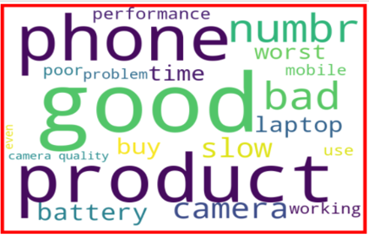
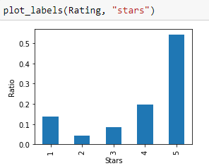
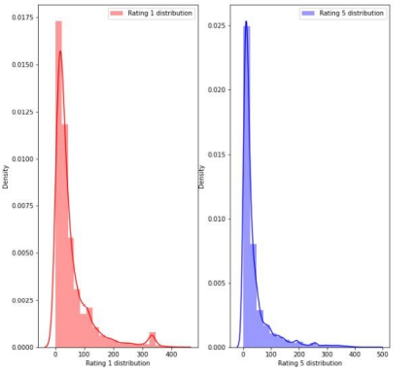
Exploratory Data Analysis through Visualizations
Maximum 27754 numbers of ratings present are of 5 star and
minimum 2204 is of 2 star.
We then create two more columns length and clean length on the
basis of the lengths of the text before and after cleaning for our
analysis purpose.
By looking into the target variable label we assumed that it was a Multiclass classification type of problem. We observed that dataset was imbalance so we will have to balance the dataset for better outcome
Stop words are commonly occurring words in a language like ‘the’, ‘a’, and so on. Most of the time they can be removed from the text because they don’t provide valuable information.
This is another text processing technique that will help to treat words like ‘hurray’ and ‘hurray!’ in the same way.
The words, ‘TEXT’, ‘Text’, ‘text’ all add the same value to a sentence lowering the case of all the words is very helpful for reducing the dimensions by decreasing the size of the vocabulary.

Slide 6
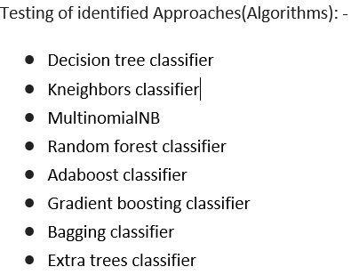
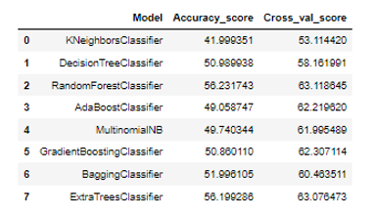
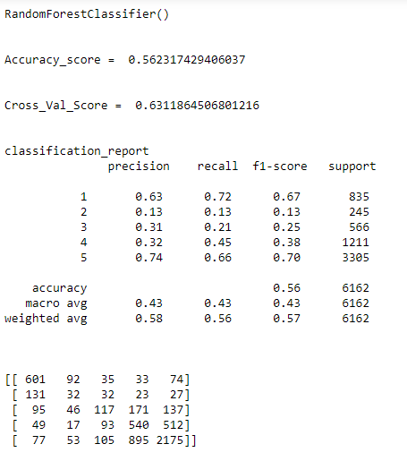
Model/s Development and Evaluation :
I have performed multiple algorithms to get the best model, and found out Random Forest Classifier is the best fit model out of all the other algorithms based on Classification matrix & Cross validation score as shown in this slide.

Slide 7
Conclusion
KEY FINDINGS AND CONCLUSIONS OF THE STUDY
In this project we have tried to detect the Ratings in commercial websites on a scale of 1 to 5 on the basis of the reviews given by the users. We made use of natural language processing and machine learning algorithms in order to do so. We interpreted that Random forest classifier model is giving us best results.
LIMITATIONS OF THIS WORK AND SCOPE FOR FUTURE WORK
While we couldn’t reach out goal of maximum accuracy in Ratings prediction project, we did end up creating a system that can with some improvement and deep learning algorithms get very close to that goal. As with any project there is room for improvement here. The very nature of this project allows for multiple algorithms to be integrated together as modules and their results can be combined to increase the accuracy of the final result. This model can further be improved with the addition of more algorithms into it. However, the output of these algorithms needs to be in the same format as the others. Once that condition is satisfied, the modules are easy to add as done in the code. This provides a great degree of modularity and versatility to the project.

Slide 8
Thank you

